Slide 1

MARKETING SEGMENTATION
Abdulkhodiy Nematov NF1004928
Teddy Fabrizio Baeny Vargas NF1005996
Cristian Camilo Alfonso Mojica NF1007669
Brenda Carolina Amparo Gracia NF1004311

Slide 2
Theory and importance
INTRODUCTION – CUSTOMER SEGMENTATION
Classification of consumers within a market that share related needs and establish related purchasing behavioral habits. (Kotler, 2010)
Organization markets (products or services) it should focus on the various types of segmentation.
Allow businesses to focus on their consumers' behaviors and purchasing patterns.
Allows an organization to achieve its highest return on investment (ROI) in turn for its marketing and sales expenses.
(Martin, n.d.)

Slide 3


Methodology
K-means clustering
Age, income, engagement and spending used.

Slide 4
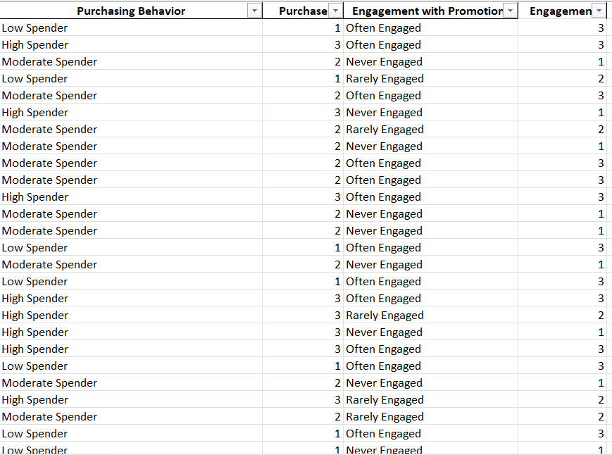
Make purchasing behavior and engagement ordinal variables

Slide 5
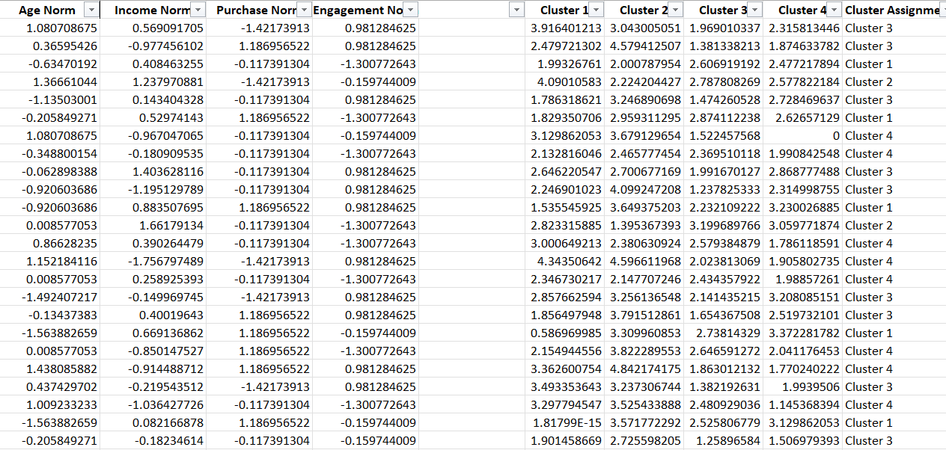
Use standardization and determine the clusters

Slide 6
SEGMENT DESCRIPTIONS
Each cluster was built considering different segmentation variables:
Age (Demographic)
Gender (Demographic)
Income (Demographic)
Location (Geographic)
Purchasing Behavior (Behavioral)
Engagement with the marketing campaigns (Behavioral)

Slide 7
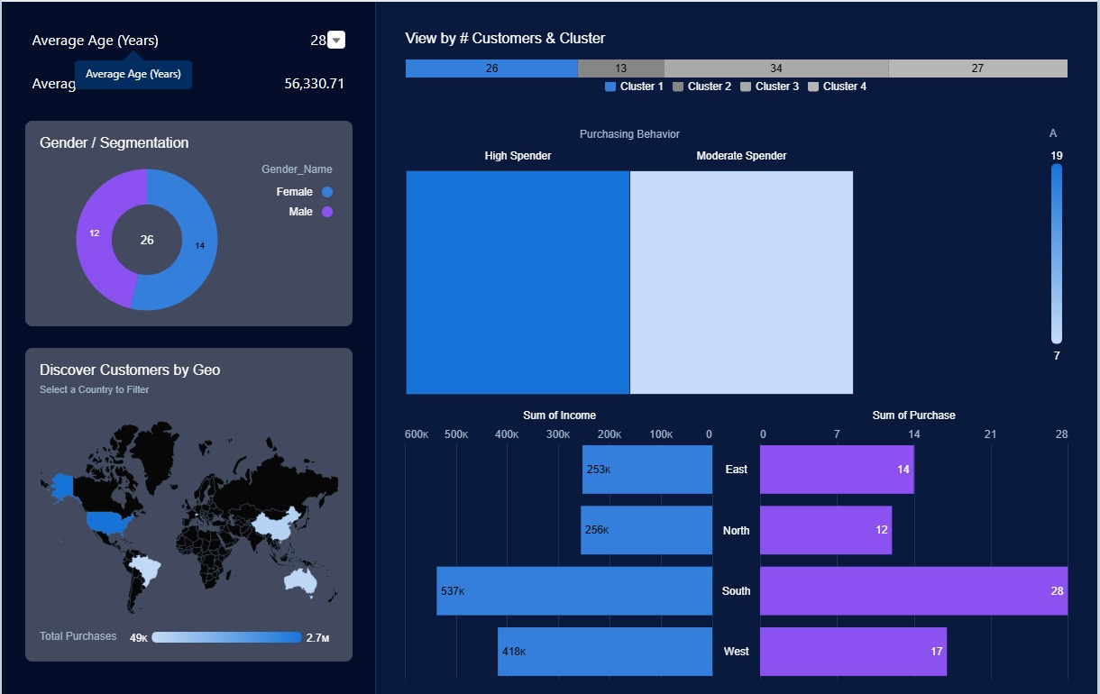
Segmentation by clusters
CLUSTER 1
Young customers (Age range from 18 to 43)
High and Moderate Spender.
Mainly Located in the south and west regions
Diverse in gender, income and engagement.

Slide 8
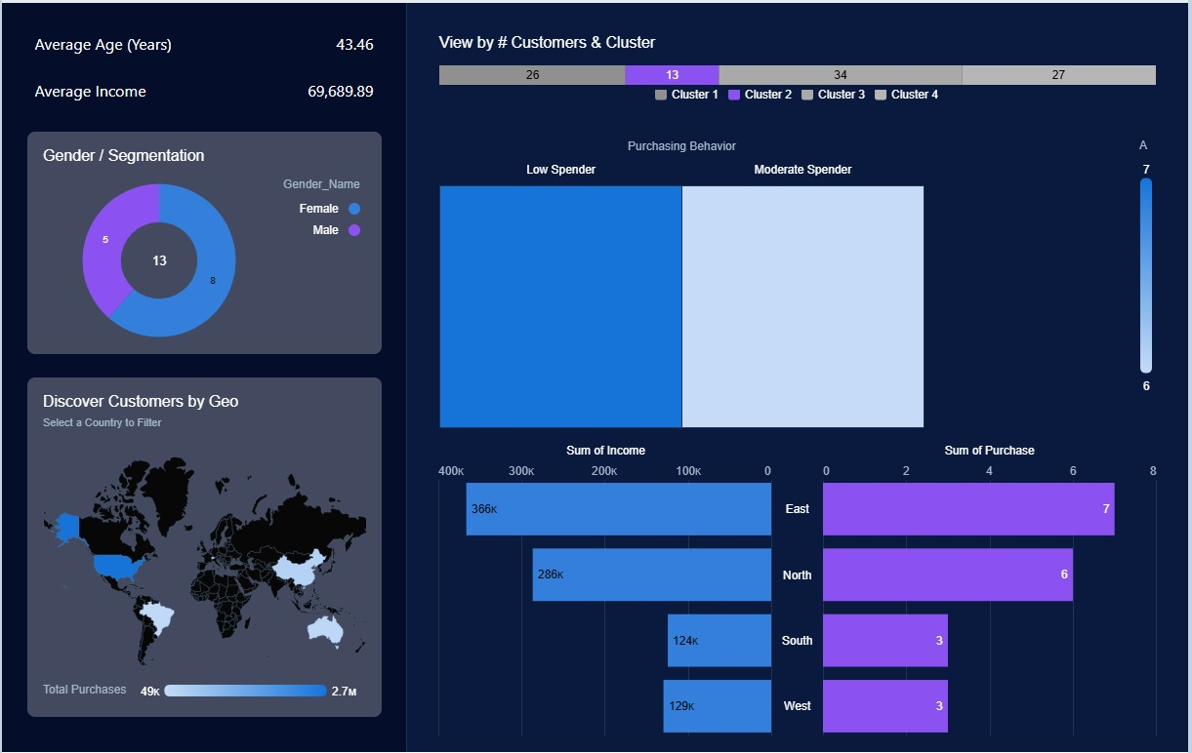
Segmentation by clusters
CLUSTER 2
Customers with Mid and High-Income levels
Low and Moderate Spenders
Located in the North and East regions
Few and Rarely engaged
Diverse age and gender

Slide 9
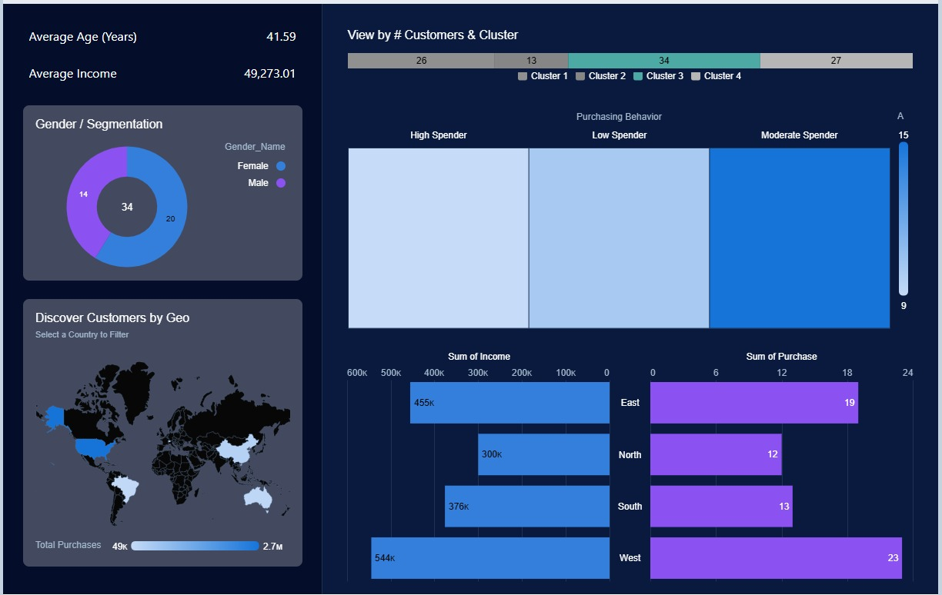
Segmentation by clusters
CLUSTER 3
Mainly Located in East and West.
Almost everyone (31) is engaged with the campaigns.
Diverse age, gender, spending and income.

Slide 10
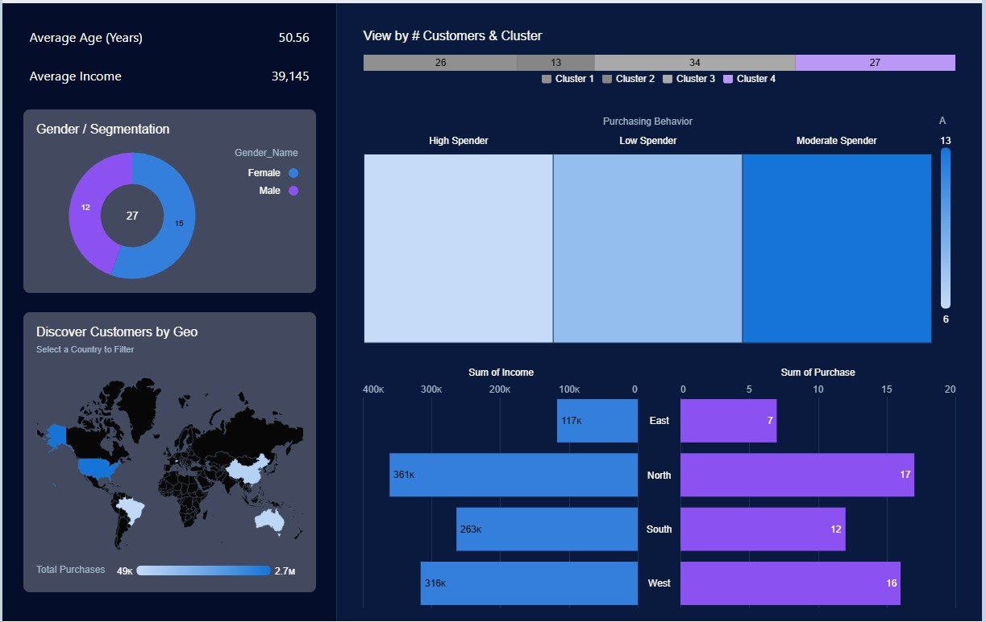
Segmentation by clusters
CLUSTER 4
Adults and seniors
Lower income level
Few or non-existent engagement with campaigns.
Diverse gender, region and purchasing behavior.

Slide 11
STRATEGIC RECOMMENDATIONS
Segment | Cluster 1 | Cluster 2 | Cluster 3 | Cluster 4
Product | Products that cater to both genders, but to younger audiences. Luxury or high-end products | Focus on products that have high lifecycle and great value for a low price. Gain these customers | Products for all ages and not gender-focused. Highlight customizable and versatile products | Products for a senior and mature audience. Daily and affordable as their income is lower
Price | Premium pricing strategy as there are mostly high spenders in the cluster. | Value-oriented pricing so consumers are interested in purchasing. Make flexible payment options. | Variety of prices so all customers feel included. Product bundles | Accessible prices and bundle offers to encourage higher spending.
Place | Leverage e-commerce platforms to ensure accessibility across all regions. Focus distribution on South and West | Free delivery, to increase convenience for low-engagement customers. Priority for east and north clients while keeping focus on others. | Provide multiple purchase options (home delivery, click-and-collect) to address demanding lifestyles and and many regions. | Online shopping platforms for accessibility, especially for regions with fewer physical locations.
Promotion | Design marketing campaigns specific to regional differences (East, North, South, and West) and target according to engagement levels. | Marketing (videos, social media) to highlight benefits and value of the product. Attract customers and educate about our brand | Personalized offers and loyalty programs. Reactivation campaign for the rarely engaged customers | Revival and awaraness strategies: Offer special deals or free trials to motivate purchases.

Slide 12
THANK YOU..

Slide 13
References
Martin, G. (n.d.). The importance of marketing segmentation. https://eric.ed.gov/?id=EJ1056632

